Slide 1


Final Year Project Proposal
Connect the Color Dots
(An IQ Test Puzzle Game)
Supervised By: Mansoor Alam (professor)

Slide 2
Project Team
Muhammad Nofal Ullah
(29409)
Sulman Siddique
(22816)
Uzair Asif
(22664)

Slide 3
Table of Content
Introduction and Background
Literature Review and Summary Table
Gap Analysis
Problem Statement
Proposed Solution & Methodology
Project Scope
Work Breakdown Structure
Roles and Responsibilities

Slide 4
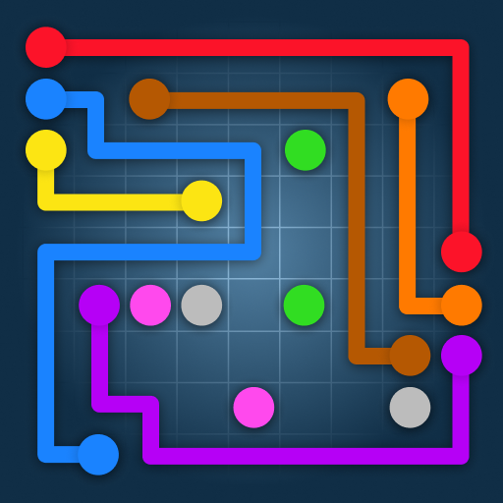
INTRODUCTION AND BACKGROUND
Android base Application
Test IQ level
Enhance cognitive Abilities

Slide 5
Overview:
Android app for IQ assessment via puzzle game.
Connect dots of same color to solve puzzles, increasing in complexity.
Benefits:
Users receive estimated IQ scores post-level completion.
Enhances analytical and problem-solving skills.
Features:
Diverse features to maintain user engagement.
Prevents boredom during gameplay.

Slide 6
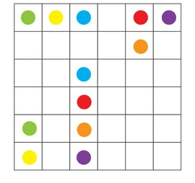
LITERATURE REVIEW
Simple Connect Dots games
No Modern Features

Slide 7
Paper name | Author | Techniques | Results | Efficiency | Advantage’s | Disadvantages
Effects of Dot-Based Puzzle Games on Working Memory | Kuo et al. | User Testing, User testing plan, Quantitative and qualitative analysis | Playing dot-based puzzle games improved working memory performance compared to non-gaming controls. | Efficient but still has some limitations to it. | Developing new skills , Building IQ level , enhancing cognitive ideas . | Playing connect the color dots games too much can hurt your hands and stop you from doing other things. Remember to take breaks and do other stuff too.

Slide 8
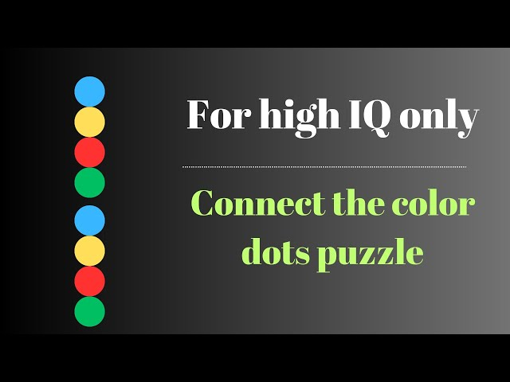
Logic building Mathematically strong Gap Analysis

Slide 9
Although many puzzle games claim to enhance cognitive abilities, most fail to directly link gameplay to IQ scores.
Most well-known puzzle games use the same ideas and designs, without introducing anything new or inventive.

Slide 10
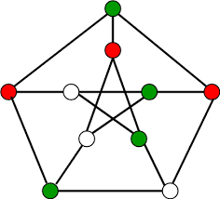
PROBLEM STATEMENT
Incorporating new features
Enhance users' skills
Logic-making abilities.

Slide 11
Challenges:
Puzzle-solving isn't universally accepted as an IQ measurement tool.
Difficult to demonstrate the value of our game without a direct IQ testing feature.
Solution:
Integrate IQ testing directly into our game.
Players can conveniently assess their IQ while playing, eliminating the need for a separate app.
Added Value:
Saves time and device storage for users.
New features enhance user entertainment and engagement.

Slide 12
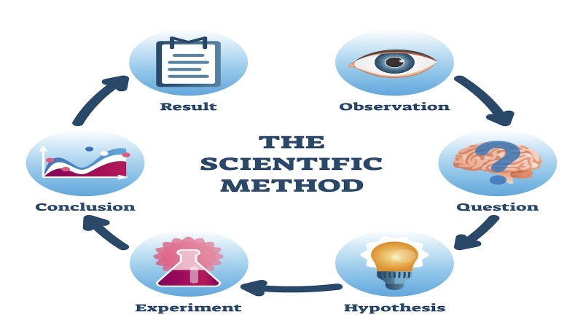
PROPOSED SOLUTION AND METHODOLOGY

Slide 13
Objective:
Create game estimating IQ from puzzle completion.
Utilize established IQ scale for scoring.
Implementation:
Design puzzles varying in complexity.
Convert completion percentiles to IQ scores.
Innovation and Expansion:
Regularly update with new puzzles and features.
Ensure game remains engaging for user retention.

Slide 14
PROJECT SCOPE

Slide 15
Define the boundaries of the project.
Including the target audience of users of all ages.
Focus on enhancing skills and logic through puzzle games.

Slide 16

Work Breakdown Structure

Slide 17
Break down of the project is into two parts.
Our project will be done in two phases Documentation and Development.
Documentation will be done in first phase of FYP_1 where we gathered our requirements and development will be done in second phase of FYP_2.

Slide 18
Roles and Responsibilities
Documentation
Development

Slide 19
UI/UX design
Documentation
Development

Slide 20
Model , Algorithms and Tools
Using Agile Model
Unity 3D for developing
Adobe illustrator for UI and UX
Round Robbin and A*(star)

Slide 21
CONSTRAINTS AND LIMITATIONS

Slide 22
IQ Assessment Requirement:
Complete first level for IQ check.
Incomplete first level prevents IQ assessment.
Matrix Completion Constraint:
Fill entire grid to advance.
Failure to fill grid halts game progression.

Slide 23


